Slide 1
Aviation sector data analysis
Exploring data infrastructure and its operational and financial importance in decision making

Slide 2
Dataset components(Dataset Structure)
The analytical environment consists of four main integrated tables covering operational, financial, customer reservations, and passenger data.

Slide 3






Basic system tables
Operations and aircraft
Reservations and tickets
Customer and loyalty data
Includes fleet data, aircraft models, aircraft ages, maintenance costs, fuel consumption, and safety ratings.
It contains reservation details, ticket prices, discounts, item weights, payment methods, and customer satisfaction ratings.
Tracks personal passenger information, loyalty tiers, membership tiers, and annual travel rate.

Slide 4
Schedule details and scheduling of flights
Schedule Management: Accurately compares scheduled and actual take-off and landing times to accurately calculate delays (Delay_Minutes).
Geographical routes: linking departure and arrival airports and calculating distances in kilometers (Distance_KM).
Status follow-up: Records flight statuses such as (scheduled, departed, delayed, or cancelled) and the reasons for cancellation, if any.

Slide 5
The importance of this data in business analysis
How data engineering and analysis transform operational processes into profitable strategic and financial insights.

Slide 6
Strategic returns from analysis
Improving operational efficiency: Linking fuel consumption to distances and flight times to identify the most economically efficient aircraft.
Precise financial control: Using indicators such as the Maintenance-to-Operating Ratio to predict emergency repair costs and make the decision to retire old aircraft.
Enhancing customer loyalty: Analyzing traveler behavior across loyalty programs and age groups to provide personalized offers that increase customer satisfaction rates.
Predicting delays and cancellations: Building machine learning models that predict the causes of delays and minimize associated operational losses.

Slide 7
Data analysis stages

Slide 8
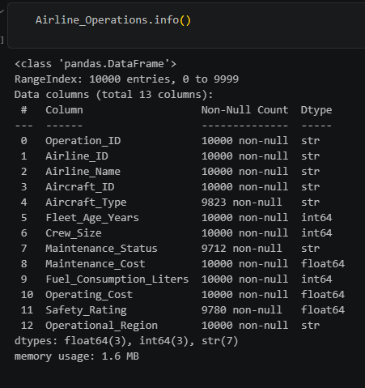
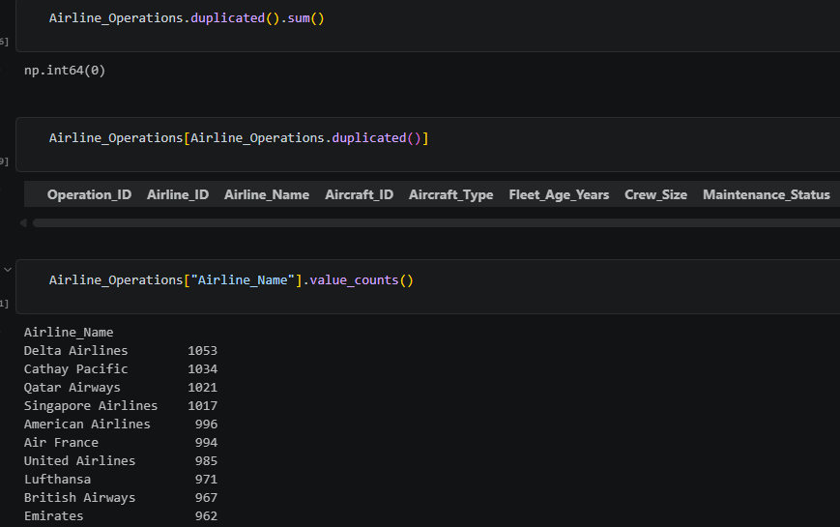
1) EDA

Slide 9
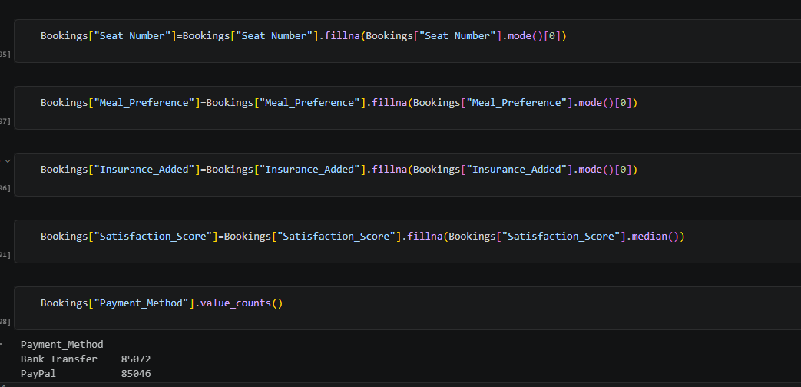
2) Data Cleaning

Slide 10
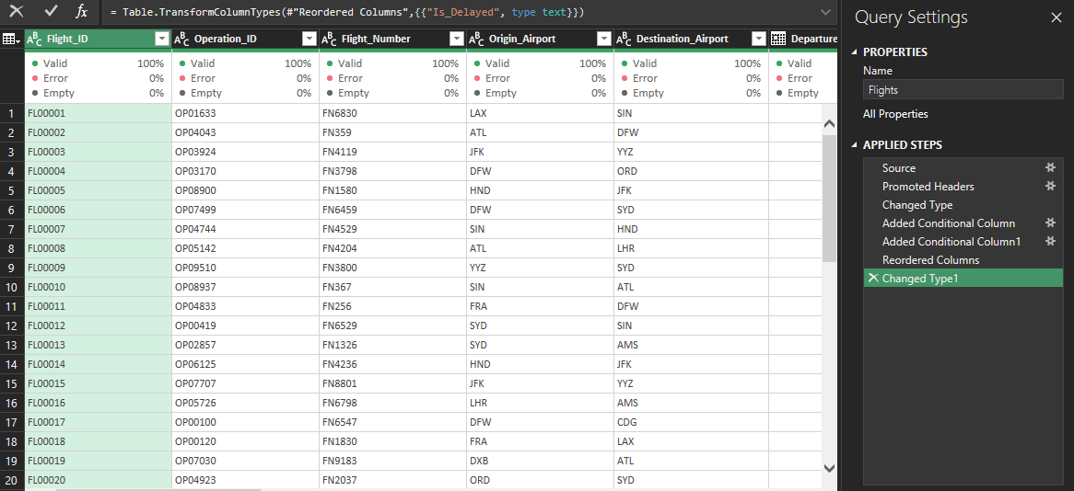
3) features engineering

Slide 11
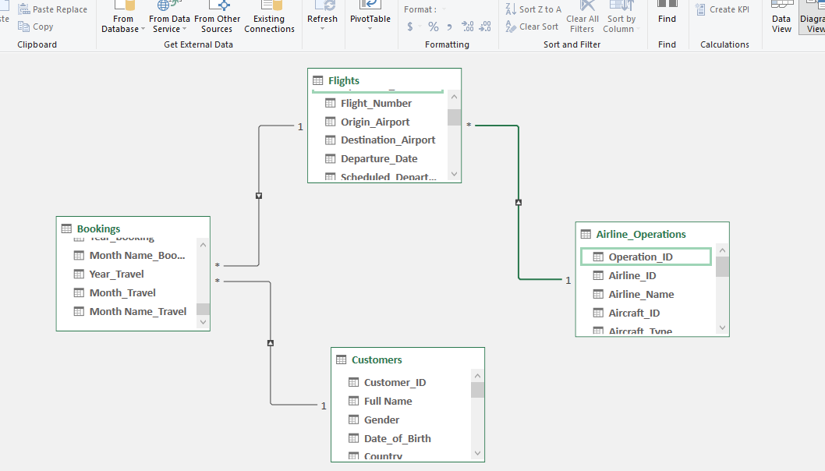
4) Data Model

Slide 12
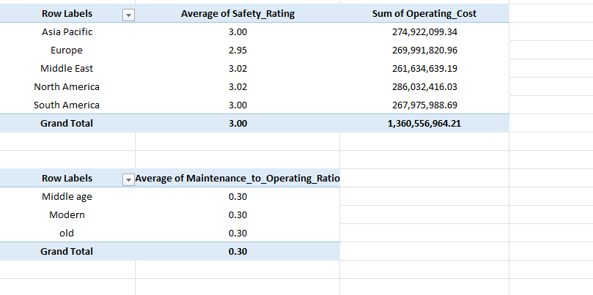
5) Summarize

Slide 13
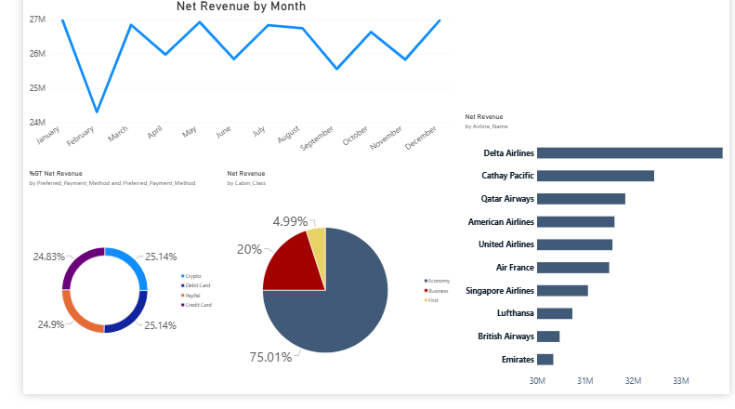
6) Dashbord

Slide 14
Thank You

